Slide 1
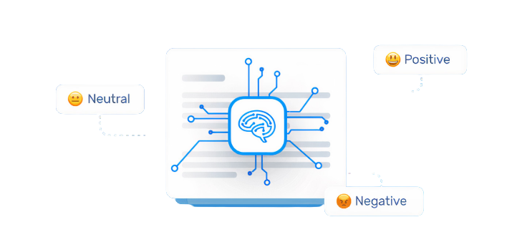
Sentiment Analysis On Amazon Product Reviews
GROUP 14
Avish Kadakia
ID: 1132452
Prithvisinh Jhala
ID: 1137435
Dhyankumar Shah
ID: 1131707
Sushmita Darimadugu
ID: 1159112
Vikas Patel
ID: 1141148
COMP 5014 GDE NATURAL LANGUAGE PROCESSING
Notes:
Hello all, Our project topic is performing sentiment analysis on amazon product reviews. All team members have contributed equally for this. But as there is a time constraint it will be only me Avish Kadakia who will be presenting.

Slide 2
TABLE OF CONTENTS
NO. | TITLE
1 | INTRODUCTION
2 | IMPLEMENTATION
4 | SYSTEM OVERVIEW DIAGRAM
5 | METHODOLOGY
6 | CLASSIFIERS USED FOR PREDICTION
7 | RESULTS
8 | CONCLUSION
9 | FUTURE WORK
Notes:
We will start the presentation introducing sentiment analysis and the problem statement. We will then go through some related work after which we will move to our implementation, approach and methodology. After discussing some specific about the classifier we have used we will then discuss results and then move on to conclusion and future work

Slide 3
INTRODUCTION TO SENTIMENT ANALYSIS
The web has given its users the freedom of speech using which they can write their unbiased opinions in a blog or review.
We can examine these user reviews to predict the behaviour of consumers and also identify new opportunities in the market.
This process is called sentiment analysis and is known as opinion mining.
Sentiment analysis, particularly the automatic analysis of written reviews in terms of positive or negative valence, has been extensively studied in the last decade. It has been widely accepted by the research community that written movie reviews seem to be rather arduous to handle. Why? One of the apparent challenges in classifying textual amazon reviews is that sentiment words often relate to the elements of an amazon product rather than the reviewers’ opinion.
Once we carry out a Sentiment analysis on product reviews, then Amazon can customize ads and discount offers displayed to each customer according to their search history or needs. That would make the interface more user friendly
Notes:
Predicting behaviour of consumers to identify opportunities in the market can be classified as sentiment analysis. The senstiments can majorly be divided into 3 categories positive negative and neutral

Slide 4
IMPLEMENTATION
We have tried to implement a variety of different feature extraction techniques with different classifiers to perform sentiment analysis.
At the end we will also compare all results, and share our thoughts on future work as well.
We have chosen the Amazon product review database for our problem statement as it has over 9M labelled user product reviews. Each review has a rating from 1 - 2 (negative), 3 (neutral) and 4 - 5 (Positive). Where (1) is the worst and, (5) is the best.
We have not used the whole dataset but just review for wireless products as there are over 9 million reviews for each products category. Our training and testing split is 66% (Training) and 33%(Testing)
We have calculated results for these 2 conditions after re-labeling the ratings to start from 0 instead of 1:
3 classes for ratings 0,1,2
5 classes for ratings (0-2), (3), (4-5)

Slide 5
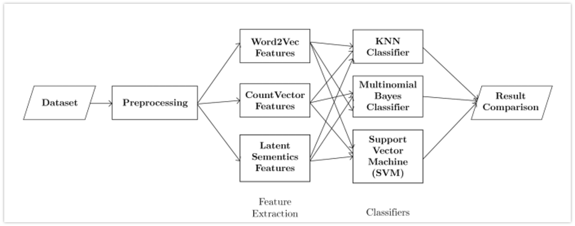
SYSTEM OVERVIEW DIAGRAM

Slide 6
METHODOLOGY
Importing the Dataset
Data Preprocessing
Word Embeddings / Feature Extraction
Making predictions using classifiers

Slide 7
CLASSIFIERS USED FOR PREDICTION
KNN
The main idea in KNN is to calculate the distance between each word vector during our training process.
We then compare each new word vector with these distances to obtain the K nearest neighbors and make our predictions.
The only drawback of using KNN is that it may have a very high time complexity if the dataset is too large.
Multinomial Naïve Bayes
In Multinomial Naive Bayes, we will calculate the probabilities of each word for a given document, using the Bayes formula.
We can then calculate the highest probability and assign that class to a new document.
SVM (SGD Classifier)
SVM is a supervised learning model that has a solid theoretical foundation and performs classification more accurately than most other simpler algorithms in many applications but in recent studies deep learning and more complicated model have out performed svm.
Many researchers claim that this is the best text classifier and can be used for sentiment analysis to get great performance.

Slide 8
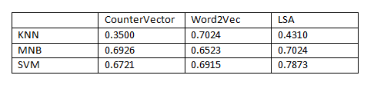
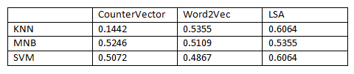
RESULTS
(TESTING ACCURACY)
3 classes for ratings (1-2), (3), (4-5) :
5 classes for ratings (1,2,3,4,5) :
Notes:
Avish

Slide 9
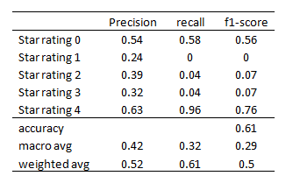
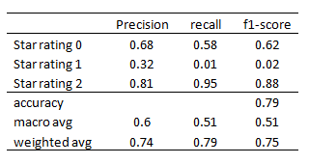
RESULTS
(TESTING ACCURACY)
Notes:
Avish

Slide 10
CONCLUSION AND DISCUSSION
As per our experimentation results, it can be clearly observed that more than the transformation techniques and classifiers used for sentiment analysis the number of classes has a much higher impact on the accuracy especially for the dataset we have used.
There may be multiple reasons for such performance, but as per our understanding, this is because even as humans if we are given a review with a rating of 5 and asked to classify it, we may just as easily classify it as having a 4 rating.
The main reason for this being providing a rating for a review can be quite arbitrary and is heavily influenced by an individual’s opinion and cannot be predicted, as 2 people who may be given the same review may rate them differently based on their opinions.
This makes it quite hard to find a determinable pattern to rate reviews for a classifier. As a result, even the algorithms that we currently use cannot guarantee high accuracy.

Slide 11
CONCLUSION AND DISCUSSION
The current methods are best at approximating at a high level if a review is positive or negative rather than predicting the exact rating for the reviews.
As it is clearly evident from our results even though the same embedding techniques and classifiers were used, the accuracy we achieved for 3 classes and 5 classes vary drastically.
It is also reasonable to conclude for the dataset using a combination of SVM with LSA as a feature extractor provides us the best results.
But is also interesting to observe that KNN had the worst performance which was significantly worse than the other classification methods. As per our understanding this may be because KNN is an unsupervised learning algorithm so while training it did not have access to the ratings which may have made it very difficult for the model to create the clusters.

Slide 12
FUTURE WORK
As it is quite evident the biggest issue is the decrease in accuracy as the number of classes increases.
So for the future, we may want to train on the complete dataset using machine learning models.
This is because given a large enough dataset machine learning models like ANNs, CNN, etc. may be able to learn various patterns which may help them better predict the ratings for a review.]
Also a frontend and a backend system can be created to create a SaaS application similar to IMDB or Rotten Tomatoes but for amazon products instead

Slide 13

Thank you!

